Slide 1
Innovative EdTech
Lessons Learned and Emerging Practice
Rob Wraith
Head of Learning Technology - NCG
Notes:
Notes provided for training throughout as necessary

Slide 2
Session
Introduction
EdTech Development
How much further we need to go…..
Questions

Slide 3
Introduction
Social
Twitter @rwraith7 LinkedIn: www.linkedin.com/in/rob-wraith-edtech
Who ?
Seek opportunities to leverage digital approaches throughout education.
Rob Wraith
Head of Learning Technology and Digital Learning at NCG

Slide 4
EdTech Development
Software applications to name but a few that have enabled us….

Slide 5
EdTech The questions I ask myself…….
Now we have returned to face to face teaching:
Have we returned to the previous ways of delivering teaching learning and assessment in the classroom?
Do colleagues continue to use technology in the classroom?
Do our students expect a certain element of interactive online learning?
Do our students ask for online interactive content?
Will our online resources enhance the learning experience?

Slide 6
EdTech
What the research says…….
England, as globally, EdTech is now an established part of the education landscape.
Building digital skills and confidence – teacher’s digital skills gaps within schools and colleges are an area for attention to harness EdTech more effectively for teaching and learning.
Evidence-based EdTech teaching resources were the most popular form of future support, having been selected by just over half (51%) of teachers in the survey.
The next most popular form of policy support was the introduction of national resource centres (such as an online directory of resources), which was selected by approaching two thirds (30%) of teachers.

Slide 7
EdTech
What lessons have been learned…….
Continue to encourage staff to become involved and be confident using EdTech
Every comment and question is useful that we hear, don’t be precious
Small Chunks - 30 minute ‘Bitesize’ training and ‘Show and Tell’ sessions
Experience - Speak to curriculum staff collaborate with them
Accessibility – Understand the technology and access we and our students have

Slide 8
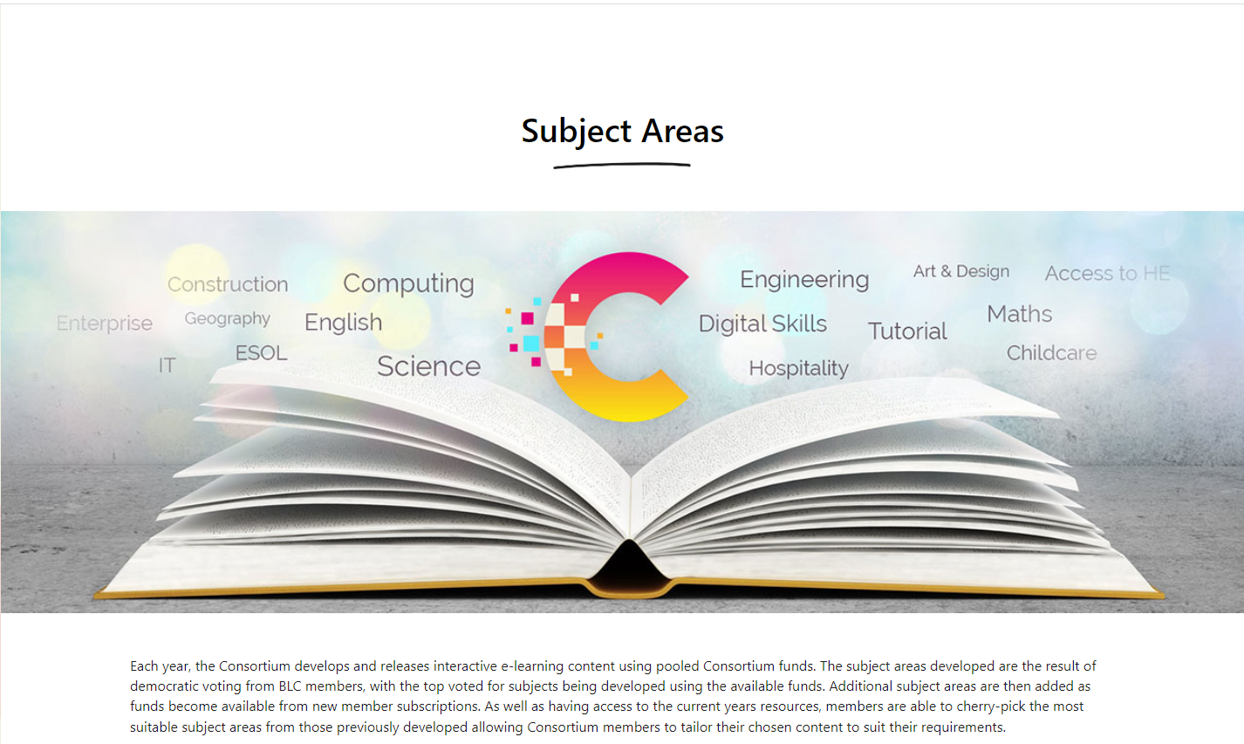
Blended Learning Consortium

Slide 9
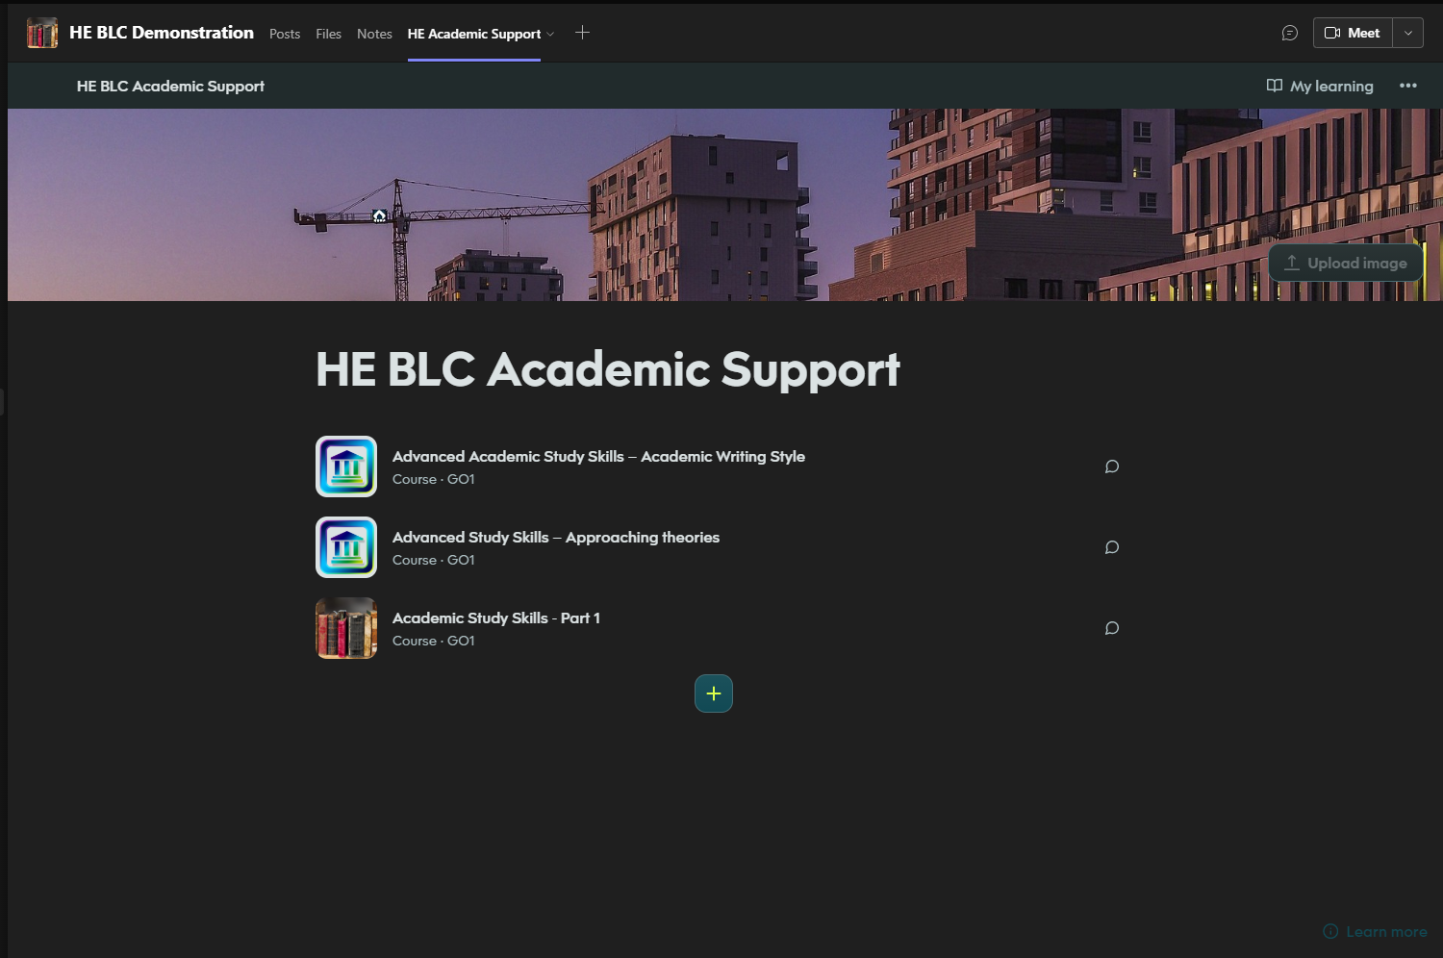
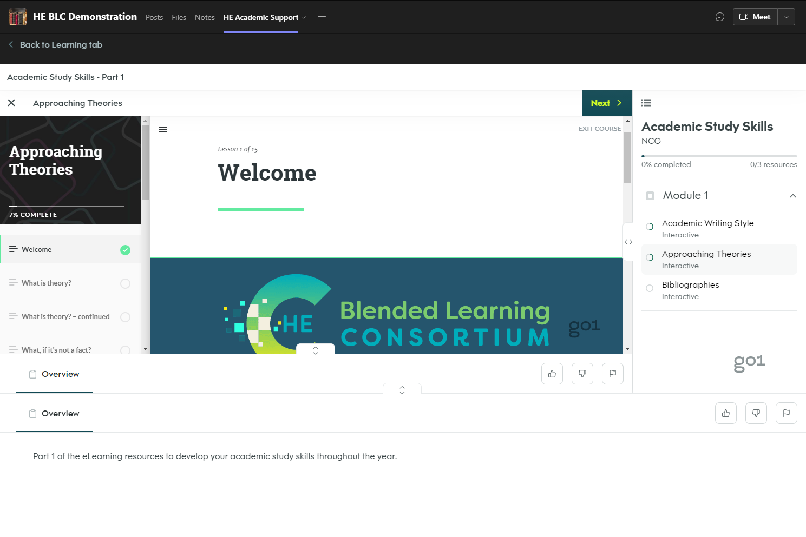
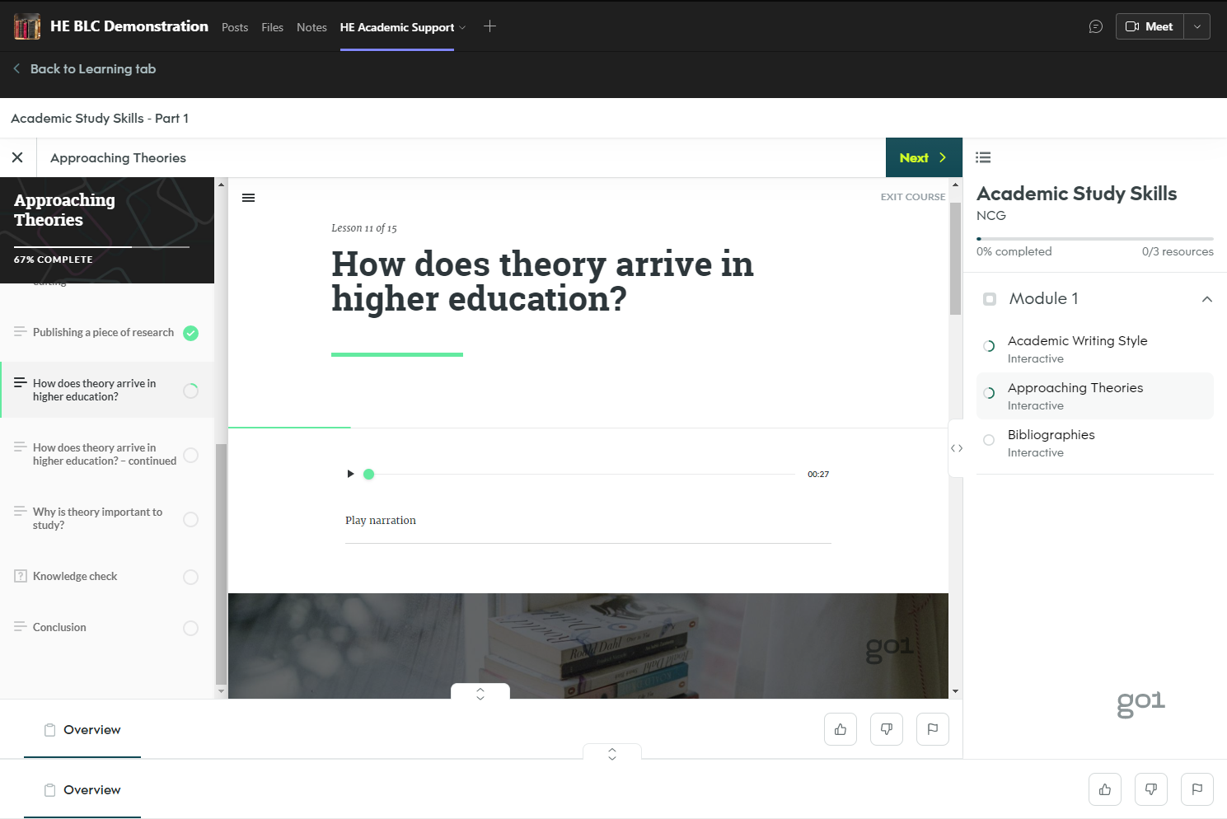
Accessing Blended Learning Resources - Teams

Slide 10
Accessing Blended Learning Resources – Go1

Slide 11
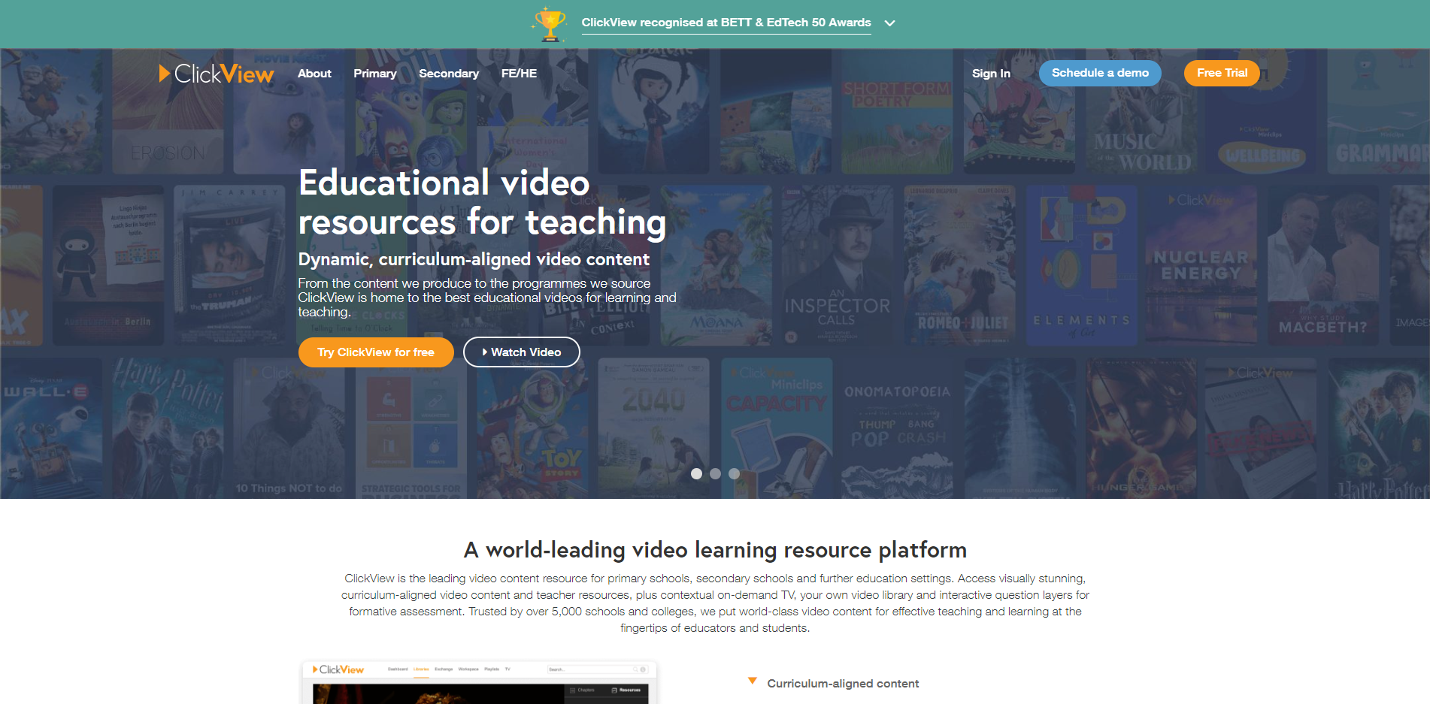
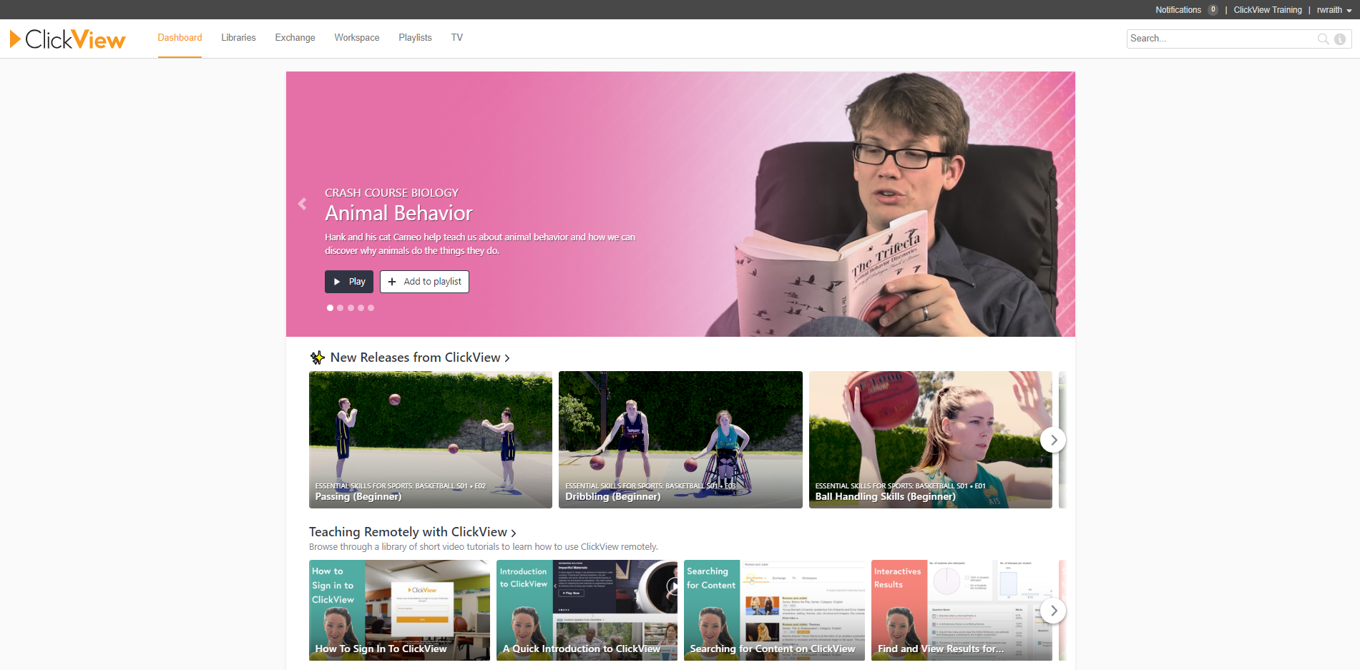
ClickView

Slide 12
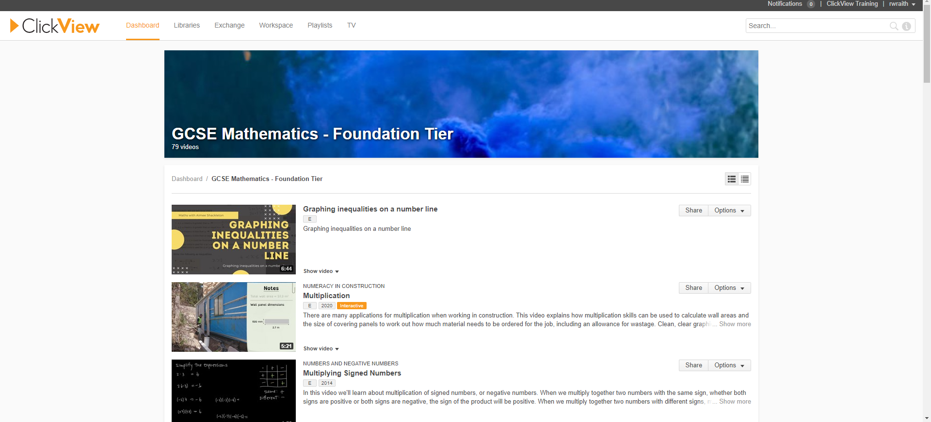
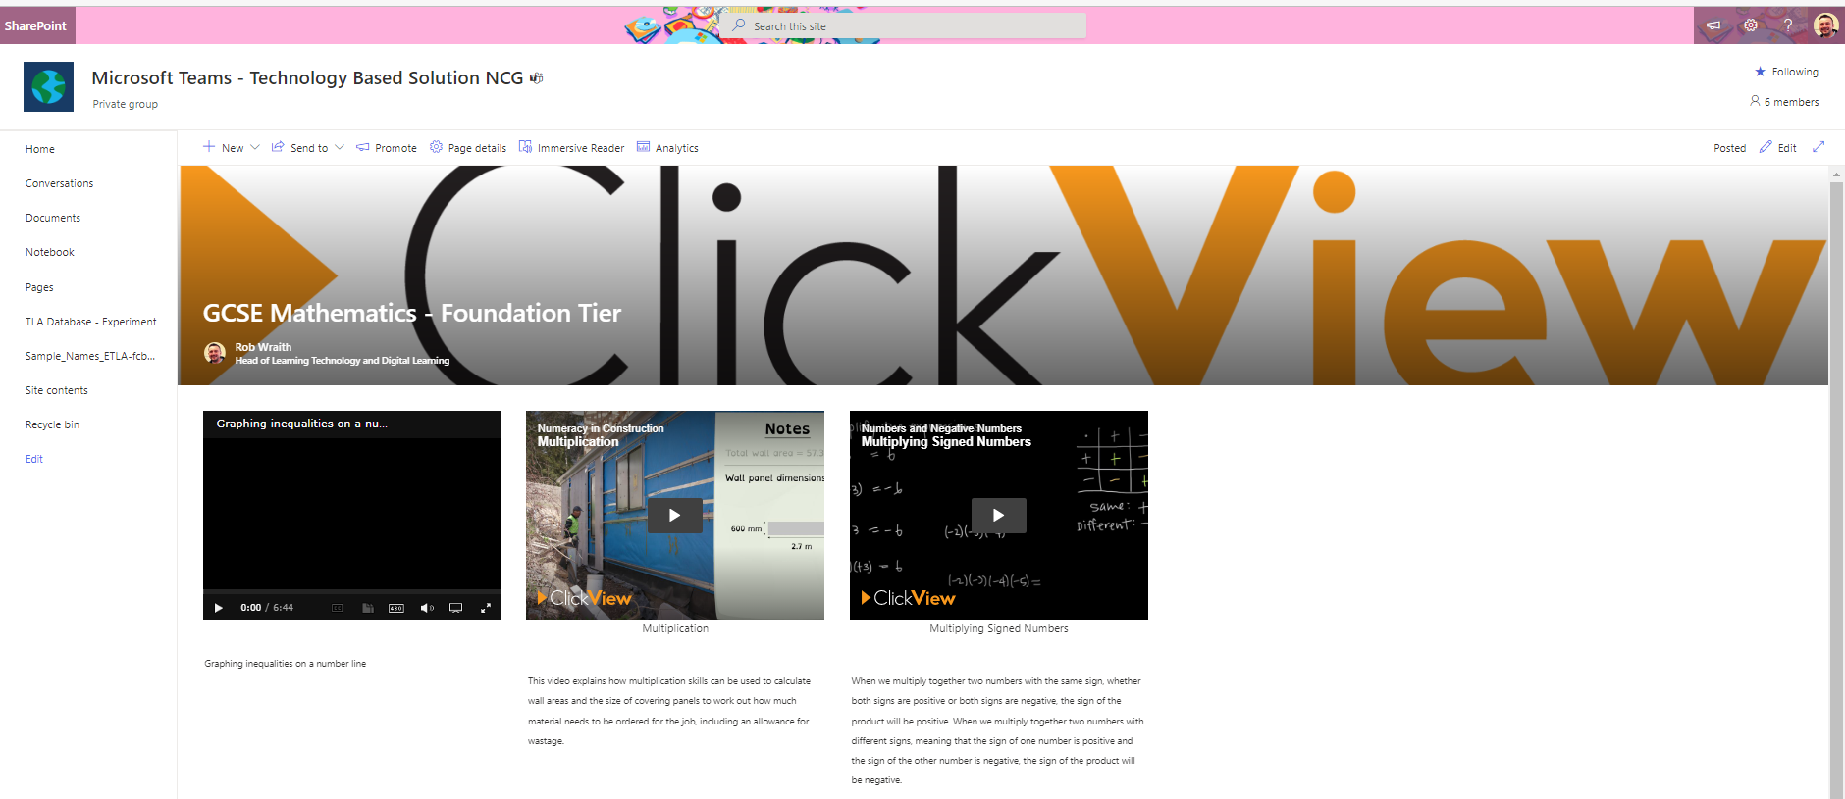
Web browser
Accessing ClickView Resources - SharePoint
SharePoint

Slide 13
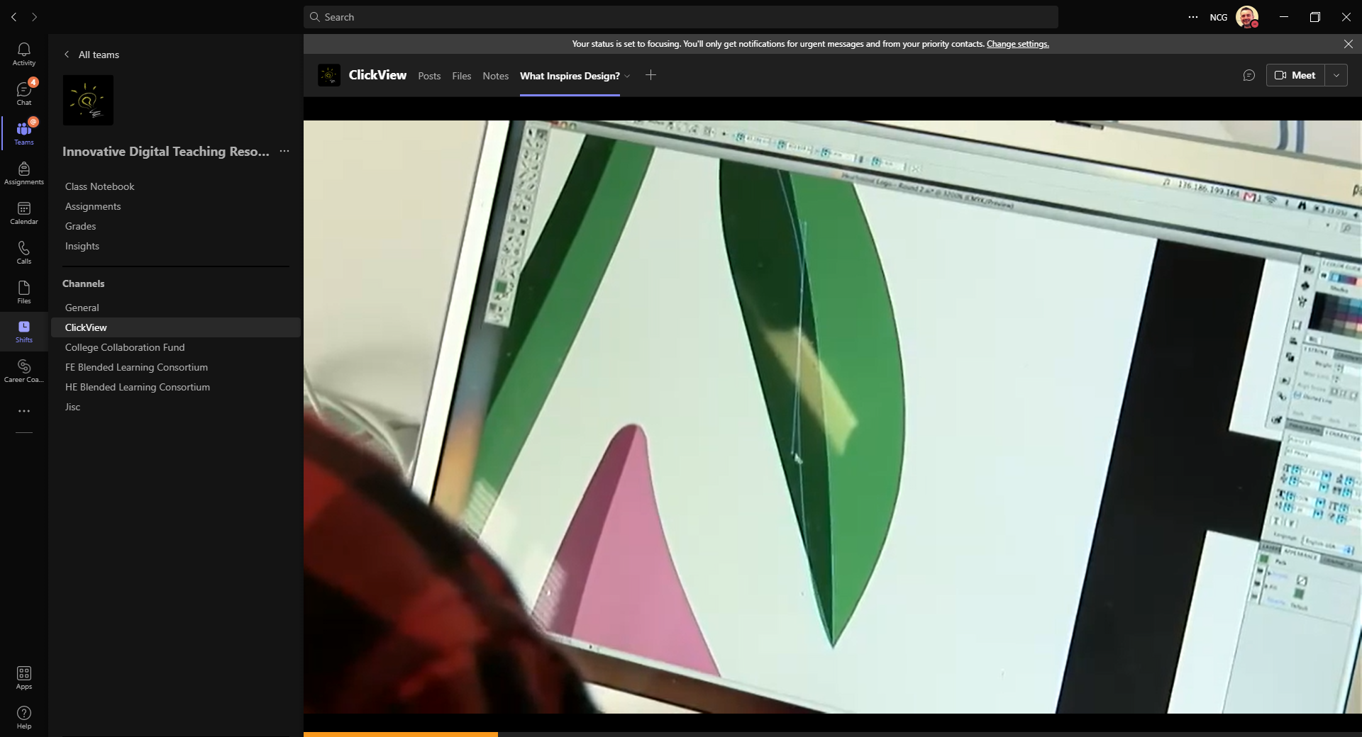
Accessing ClickView Resources - Teams

Slide 14
ClickView Resources – Wakelet and Teams

Slide 15
QR Codes and Demonstration
ClickView - Wakelet List
BLC - Wakelet List

Slide 16
Questions?

